Slide 1
AI Infrastructure Investment Thesis
(NVIDIA Case Study)
Ya Cheng Hsieh

Slide 2

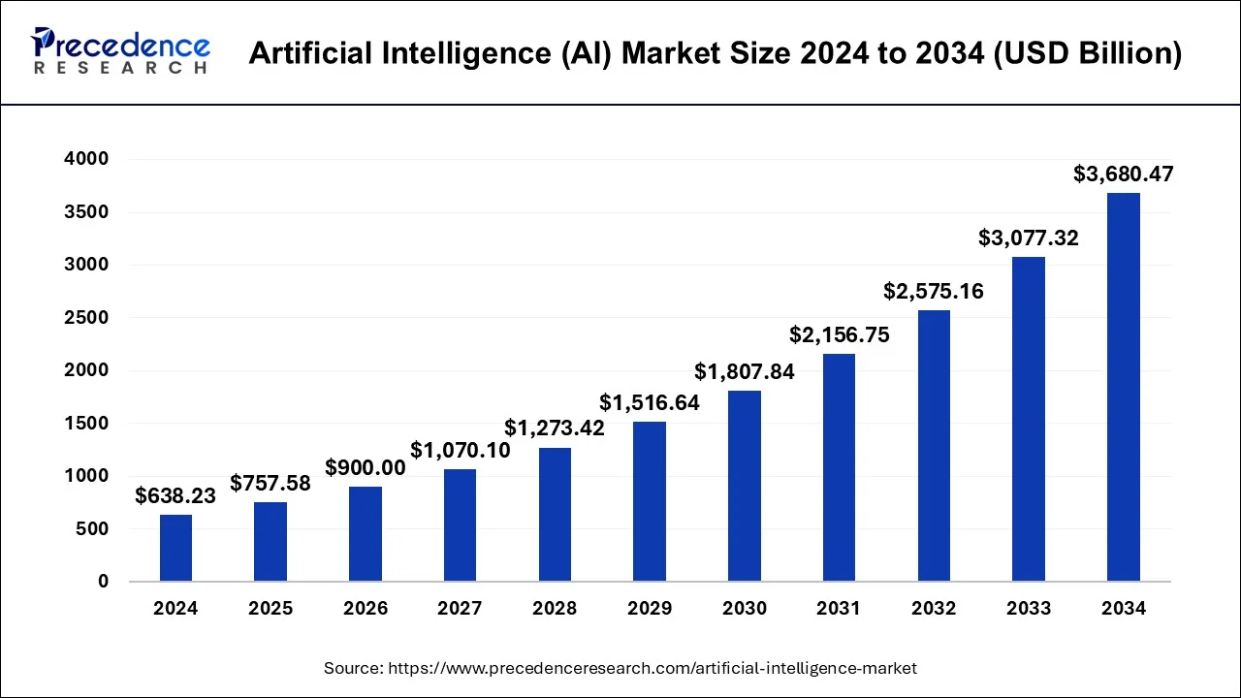
AI Infrastructure Investment Thesis
AI adoption is driving exponential growth in compute demand
Increasing compute intensity → higher energy consumption & heat generation
Creates structural demand for data centers, power,
and cooling systems
Infrastructure may become long-term bottlenecks
Investment opportunities extend beyond semiconductors

Slide 3
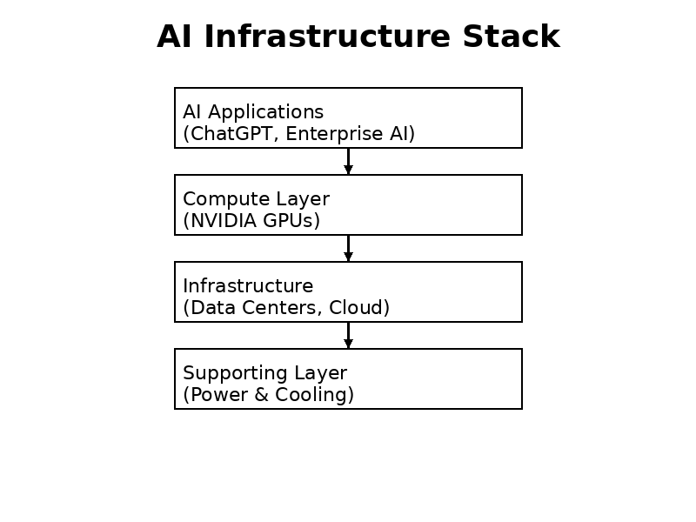

Industry Structure
AI Value Chain & Ecosystem
Core
- NVIDIA (GPU design)
Manufacturing
- TSMC (advanced chip production)
Infrastructure
- Cloud & Data Centers
Supporting
- Power systems
- Cooling / thermal management

Slide 4
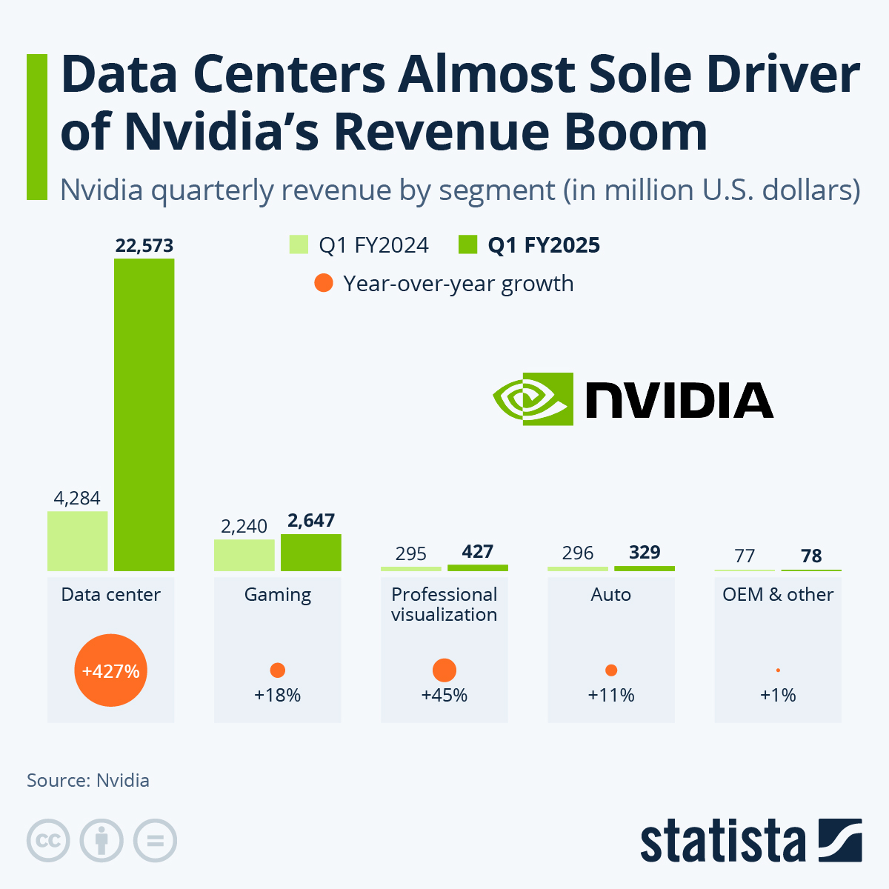

NVIDIA Analysis
NVIDIA Investment Case
Dominant position in AI GPUs
Strong demand from hyperscalers & enterprises
Pricing power due to technological leadership
Expanding role in full AI ecosystem
Risks:
High valuation
Competition (AMD, custom chips)
AI demand normalization

Slide 5

Valuation + Decision
Valuation & Investment View
Trading at a premium valuation vs peers
Reflects strong AI-driven growth expectations
Long-term growth may justify a premium
Investment View:
BUY (Long-term)
Risks:
Overvaluation
Slower AI adoption

Slide 6


Thanks!

